Slide 1
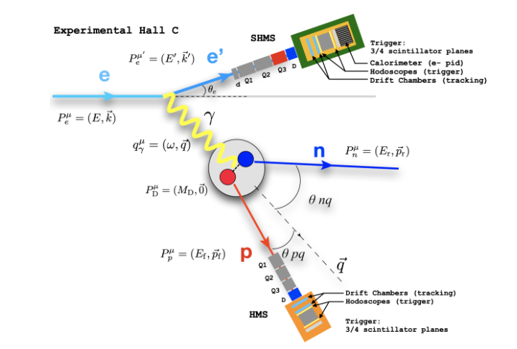

Slide 2

$Q^{2}=4EE^{′}\sin^{2}{\frac{θ}{2}}$
The proof for Q^2 starts using both momentum and energy, however it can be reduced to simply using initial and final energy and angle of the electron
Here E is the energy of the electron before the reaction, E' is the energy of the electron after the reaction, and theta is the change in the angle of the path of the electron

Slide 3

W^2 = Mp^2 + 2*Mp*nu – Q^2
$W^{2}=M_{p}^{2}+2M_{p}ω−Q^{2}$
ω = E – E'
W is the invariant mass
This means this is the mass of the system without factoring in the motion
In the case of a p(e,ep) reaction the invariant mass should be the mass of proton
In the case of an elastic reaction, there should be no change in the invariant mass before and after the reaction
But in the case of an inelastic reaction, some mass was used to change the particle which is reacting, this is known as the

Slide 4
The whole goal of going through these calculations is to understand the output of a simulation we are going to use to test our calibration
This simulation will run a theoretical version of the reaction and give a graph for the invariant mass
This invariant mass can be used to compare to the results that we receive from the invariant mass from the experimental runs that have been processed

Slide 5
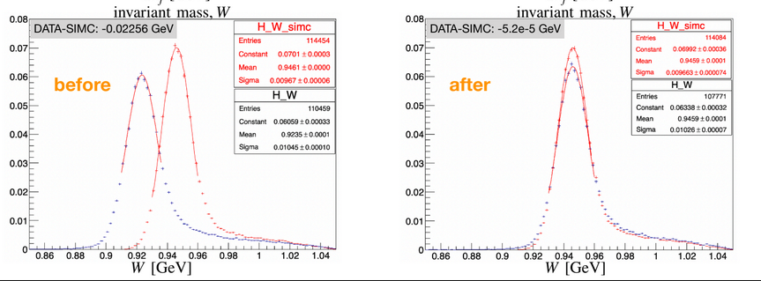

Slide 6
Let's start the simulation...

Slide 7
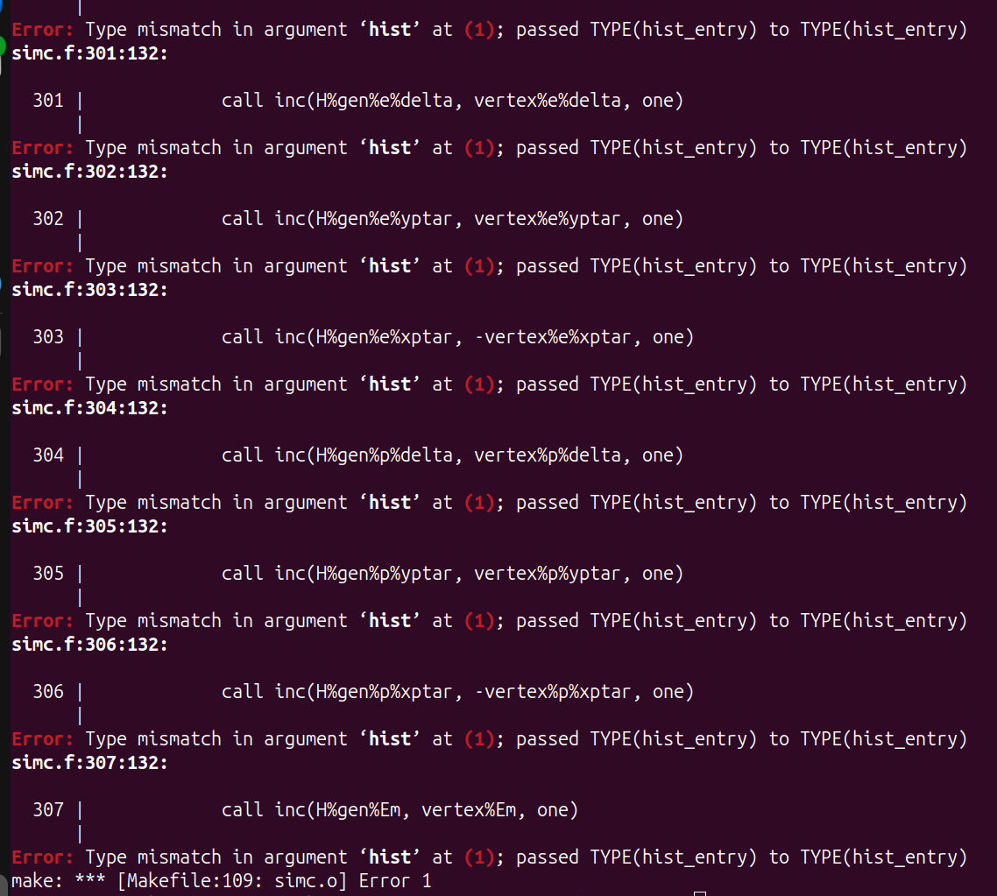

Slide 8
